Slide 1
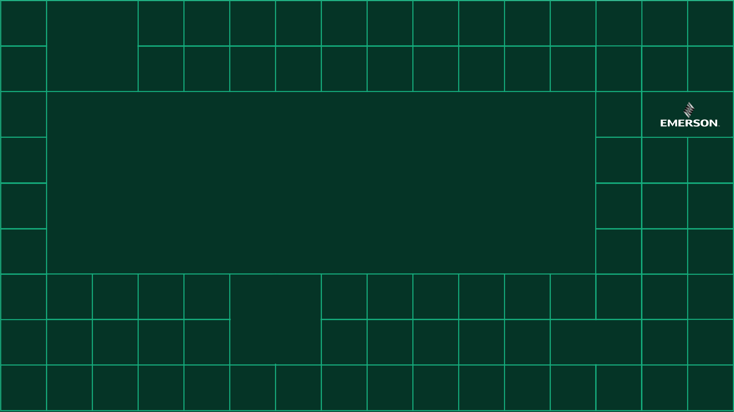








Swiss LabVIEW User Group Meeting Romandie
Strategic & Organizational News
from NI/Emerson

Slide 2



Oli Picture
Oliver Bruder
oliver.bruder@emerson.com
Book an MS Teams virtual meeting with Oliver Bruder
Country Manager Switzerland
- Started at NI Switzerland in 2001 as Applications Engineer
- New Role created by Emerson in 2025 as NI Country Mgr. for CH
You will receive those slides digital as they contain many links with more detailed information!
Notes:
Story telling: All you have to remember is providing feedback, and I will make this really easy for your ....

Slide 3
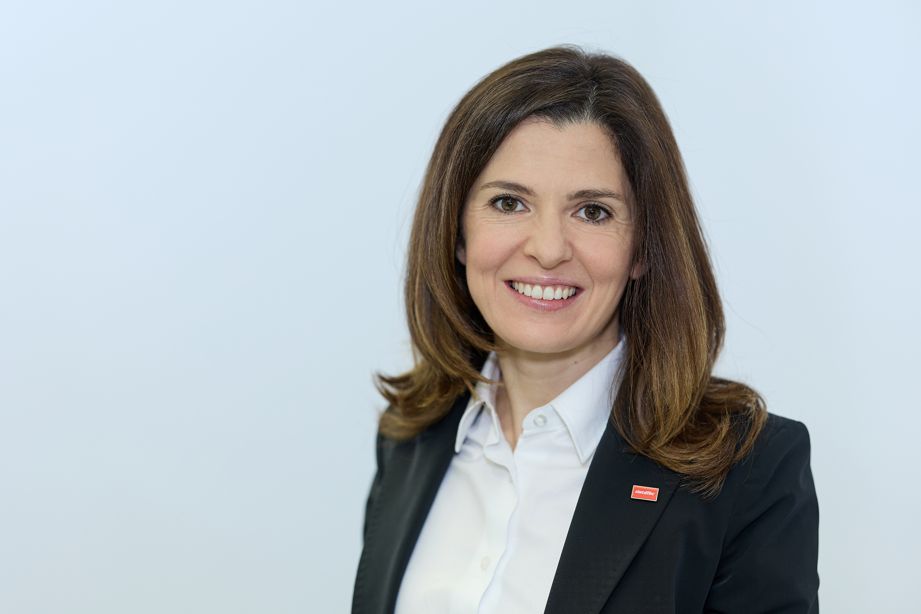
Raffaella Loforte
Sales Engineer
Master in Biomedical Engineering
Raffaella.Loforte@datatec.eu
Fluent in French, Italian and German
14 years at NI:
5 years at NI in Italy
3 years at NI in France
6 years at NI Switzerland
Since 2023 at Datatec Switzerland responsible for NI Technology
Close collaboration with NI Country Manager for Switzerland

Slide 4
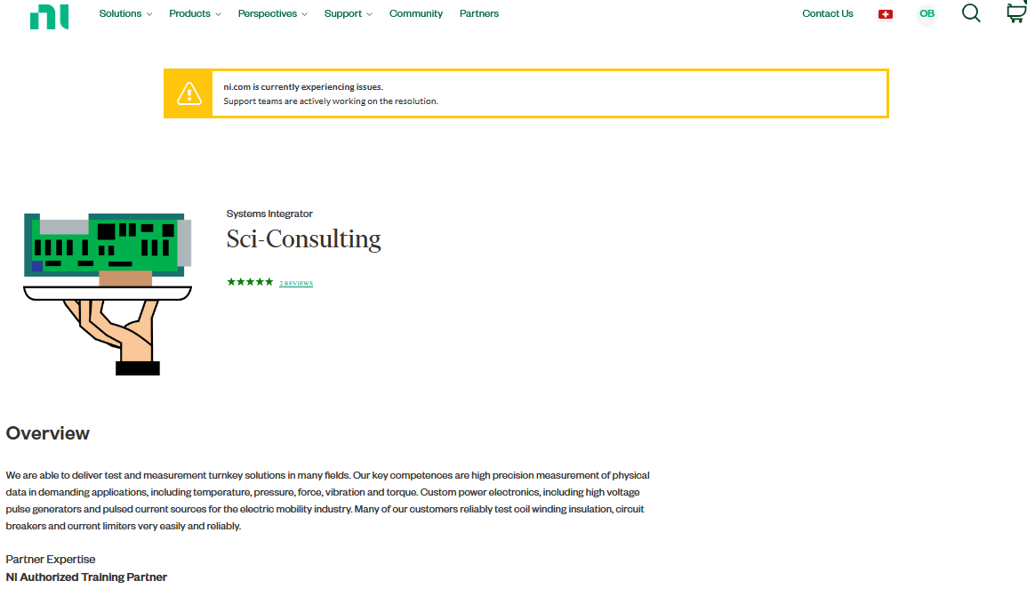

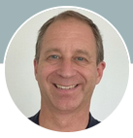
Anniversary SCI Consulting
30 Yrs. NI System Integrator Program
Congratulation to Vincent Berseth & team for 30+ yrs. of service!
Notes:
Sci-Consulting joined NI Partner Program in 1994, founded by Pierre-Alain Probst, now led by Vincent Berseth

Slide 5
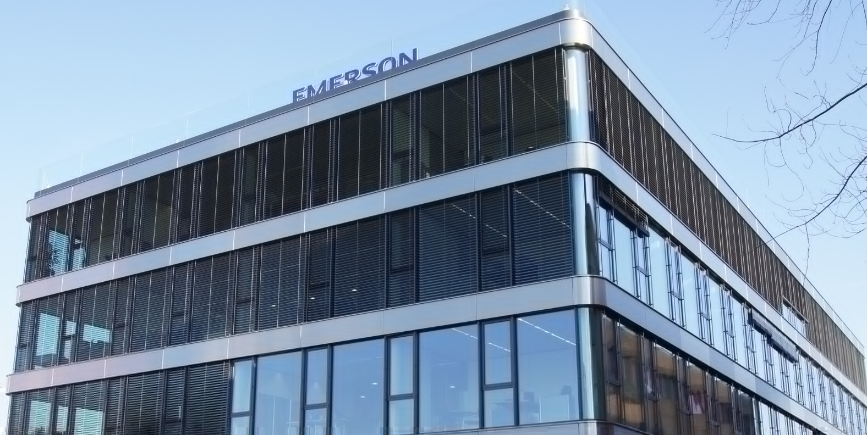

New Emerson Investment: NI Country Managers
(introduced 2025)
Sustainable, country-specific business through customer loyalty and customer satisfaction
Country Manager short-term-approach:
- Very close collaboration with official NI distributors
- Filling project-specific gaps quickly by pulling in the right NI resources quickly and appropriately
- Bi-weekly report-out to NI executive leadership team to drive improvement quickly
Mid- and long-term plan: Deploy the right resources in the right locations (globally) to maximize customer satisfaction and impact
(people working in Switzerland versus people working for Switzerland)
Your feedback will help to prioritize action!
oliver.bruder@emerson.com
Book an MS Teams virtual meeting with Oliver Bruder
Emerson European Headquarter in Baar (ZG)
Notes:
Story telling: Speaking about “investing” ... budged for ni.com ...
CM Team are 7 people reporting to VP EMEA

Slide 6
Disclaimer – “Effective versus Efficient”
2025 is the first complete year NI is operating under full Emerson ownership!
Not everything will be perfect over night!
Short-term focus is on being effective (for our customers) while potentially compromising efficiency (for NI).
We want to have a positive impact for our customers quickly:
Willing to find creative solutions for project-specific gaps, risks and challenges towards driving win-win situations.
Effectivity (for our customers) over efficiency (for NI)!
At the same time we want to maximize impact for a broad set of customers mid- and long-time (finding efficient solutions)
Your feedback will be heard!
oliver.bruder@emerson.com
Book an MS Teams virtual meeting with Oliver Bruder
Emerson European Headquarter in Baar (ZG)

Slide 7
Strategic Discussion Topics for Switzerland
Maximizing country-specific impact
Right level of technical consulting from simple products to complex solutions
NI Tech Support: Local presence and local language support versus higher # of specialists operating remotely
Influencing NI Technology Roadmaps
NI Technology Accelerator Program to support high-tech startups ( www.ni.com/oem )
Customer education and local training eco-system (training courses)
Regional communities & events: NI Days, LabVIEW user group meetings, collaboration and adoption of NI tools in Academia etc ...
[...]
Please provide feedback! 🙂
oliver.bruder@emerson.com
Book an MS Teams virtual meeting with Oliver Bruder
Notes:
Story telling: Example: Simple tech support request (share Dell-story) at night versus complex project discussions (context, trust, same language etc ....) ...

Slide 8
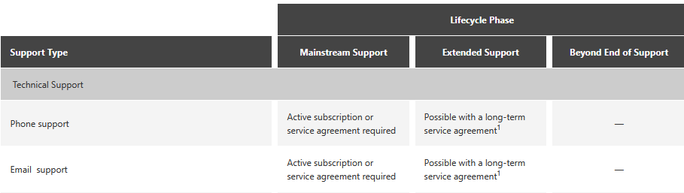
Other “Hot Topics @ NI”
Artificial Intelligence (AI) trained specifically for driving productivity with NI hard- and software: Nigel™ AI Advisor
- Integrated in new LabVIEW Professional and Teststand versions releasing later in 2025
- Check out NI Connect keynote videos Day 1 to see a demo of upcoming 1st release
- Will keep learning from users to drive productivity for the community
Best practices for maintaining LabVIEW applications over long industrial lifecycles - typically 10+ years - across software versions, OS upgrades and evolving cyber security standards such as the EU Cyber Resilience Act (CRA).
- Complex topics which are evolving quickly
- NI/Emerson is investing heavily in cyber resiliency for hard- and software
- Check out NI Software Product Lifecycle Policies
- IT world driving quick adoption of Windows11 ( www.ni.com/windows11 )
- Please approach Oliver to discuss specific needs and concerns
Book an MS Teams virtual meeting with Oliver Bruder

Slide 9
Swiss LabVIEW User Group Meeting Romandie
Enjoy the event - thanks!

